Slide 1

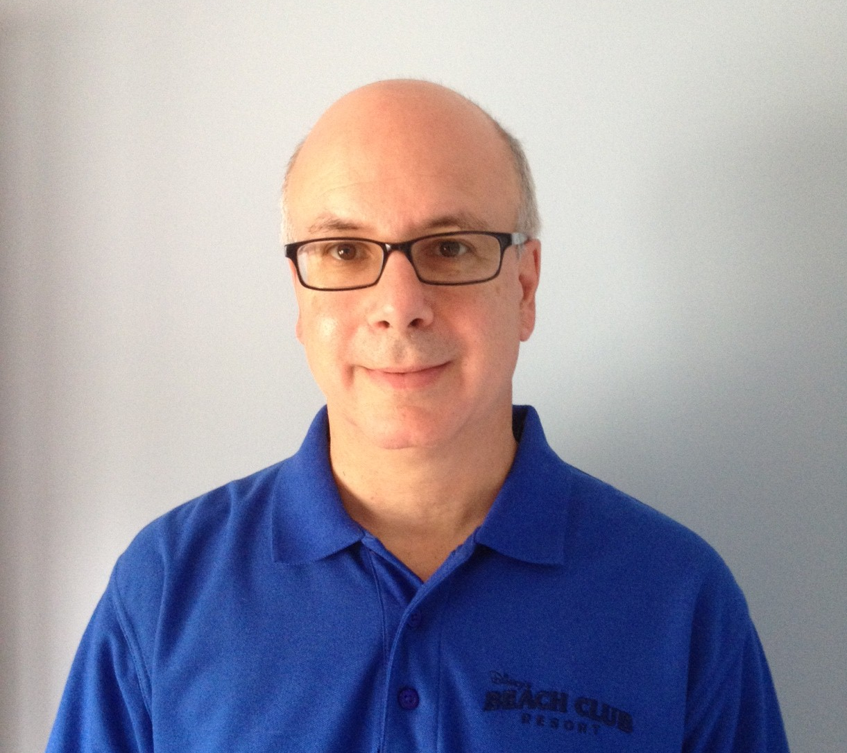
Patterns for Enterprise Success: The DevOps Journey at Nationwide
Hayden Lindsey
Vice President and Distinguished Engineer
Enterprise Modernization and Emerging Technologies IBM Software Group
hlindsey@us.ibm.com
Carmen DeArdo
Director, Tools and Technology Leader
ECTO Build Capacity
Nationwide Insurance
deardoc1@nationwide.com

Slide 2
Some facts supporting need for Enterprise DevOps
1.3M CICS trans/sec¹ vs. 68,542 Google searches/sec²
COBOL is responsible for >70% of the world’s business transactions³
Many COBOL, PL/I, and RPG programmers are nearing retirement
¹ IBM estimates based on real client usage.
² http://www.statisticbrain.com/google-searches/
³ http://fcw.com/articles/2013/12/12/cobol-legacy.aspx

Slide 3

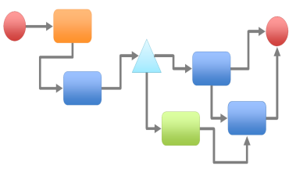




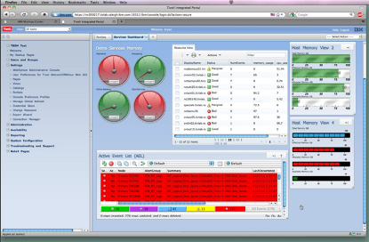



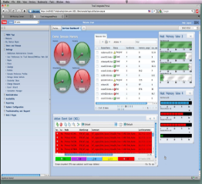



The Enterprise landscape
Systems of Record
(SoR)
Systems of Engagement
(SoE)
Drives Need
Optimize
Drives Investment
Innovate
Focus on Operational Costs
Focus on Speed and Agility
Development
Development
Operations
Development
Notes:
3
Why we need DevOps. In this world which is moving to new biz models and new technologies, we are this dichotomy in enterprise organizations between on the left side traditional development and operation focused on streamlining and being efficient, keeping efficient cost down, cloud enabled, looking at internal cloud technilogy primary as way to saving infrastructure cost down
On the right side SoE type of applications, focus on innovation, reaching to customers quickly, get innovation to market fast, customer experience.
Lefthands ide Focus on Operational Costs
Consolidation and modernization
Operations Automation
Risk and compliance Management
Manual policy to analytics driven optimization
Right handside Focus on Speed and Agility
Assemble solutions from verified components and services
Fast deployment and redeployment
Agile to DevOps model
User first delivery model

Slide 4
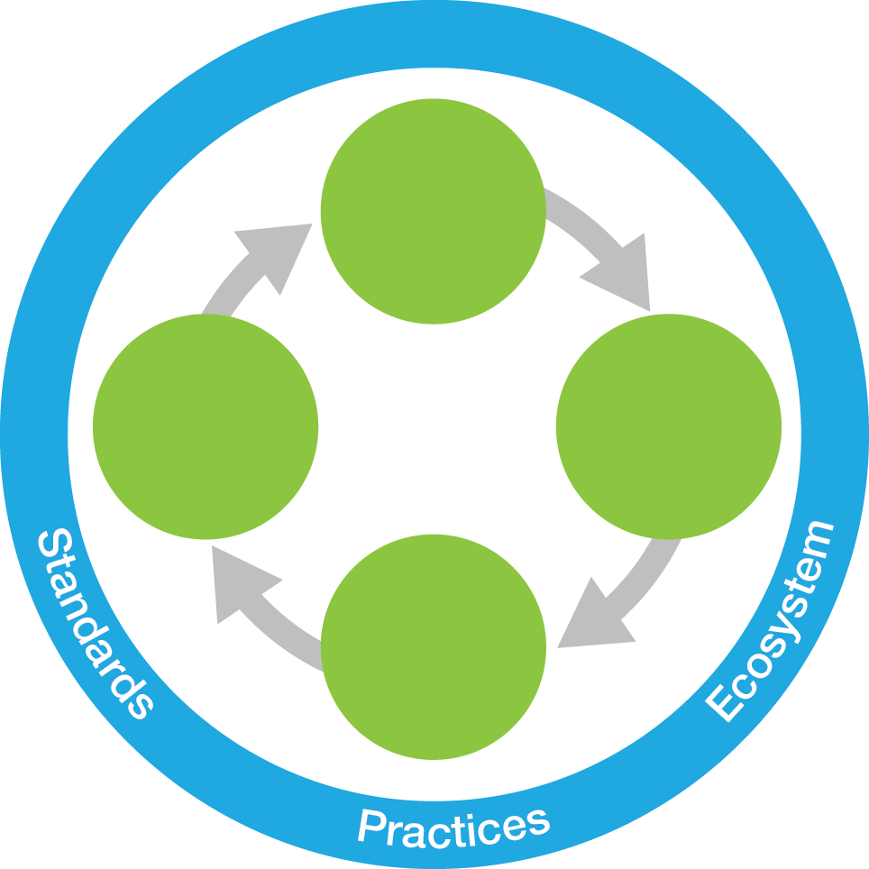
IBM DevOps point of view
Enterprise capability for continuous software delivery that enables organizations to seize market opportunities and reduce time to customer feedback
Continuous Business Planning
Accelerate software delivery – for faster time to value
Agile steering
Skills & productivity
Continuous Customer Feedback & Optimization
Steer
Collaborative Development
Balance speed, cost, quality and risk – for increased capacity to innovate
DevOps Continuous Feedback
Operate
Develop/ Test
Affordable test
automation &
virtualization
Continuous Monitoring
Deploy
Continuous Testing
Reduce time to customer feedback – for improved customer experience
Multi-platform
deployment
Continuous Release and Deployment

Slide 5
Transforming your people, processes, and systems
Ancient Infrastructure and Beliefs
Unicorn Practices
Use modern multi-platform developer & team tools
Start with small pilot projects to build confidence (execs, dev, SysAdmins)
Build a staged rollout plan and train the teams
Gain executive buy-in and sponsorship up front
Consolidate SCMs if possible
Automate deployment, configuration, and tests
Use virtualized services for testing
Offload testing from the mainframe
Use dashboards for project prioritization; view status directly from development tools
Outdated developer and team tools
Aging developer population
Disconnected teams, silos
FUD: “millennials can’t code COBOL”, “manual processes exist for a reason”, “SoR dev can’t be as nimble as distributed dev”
Ancient Practices
Manual testing
Availability of entire system is required to test
Mainframe availability required (if some z)
Reluctance to move test data off mainframe
Cross-platform coordination required
Manual project prioritization, status tracking

Slide 6
A Series of Short DevOps Case Studies

Slide 7


andagon delivers deep insights into application performance with SAP and IBM
100% improvement in application throughput, from 6,000 units per day to 12,000 units per day
70% reduction in the time to create test scripts
Identifies and eliminates issues that would have caused severe business disruption
Solution components
IBM® Rational® Performance Tester
IBM Rational Performance Tester Extension for SAP Solutions
IBM-SAP Alliance
“The Rational Performance Tester support team is excellent, providing solutions quickly and actively helping us to execute successful performance test projects with our customers.”
—Stefan Gogoll, CEO, andagon
Notes:
7
Speaker notes:
Client Name: andagon
Case study Link: http://www-01.ibm.com/software/success/cssdb.nsf/cs/STRD-949LF4?OpenDocument&Site=corp&ref=crdb
Pull Quote: "The Rational Performance Tester support team is excellent, providing solutions quickly and actively helping us to execute successful performance test projects with our customers." - Stefan Gogoll, CEO, andagon
Company Background: IBM Business Partner andagon GmbH (www.andagon.com) is a renowned consulting company in the field of quality assurance, specializing in software testing, process and test automation. Headquartered in Cologne, Germany, andagon employs more than 50 quality experts.
Solution Components: Software: Rational Performance Tester, Rational Performance Tester Extension for SAP Solutions Service: IBM-SAP Alliance
The need: Thousands of companies rely on SAP software to run their core business processes, and need to make sure that application errors do not disrupt business operations. Particularly for manufacturing companies, system downtime can cause significant financial damage as a stopped production line can result in lost profits and material loss.
Software is a key enabler for companies that wish to grow their business, manage product complexity efficiently and meet corporate targets. If software quality and performance issues are spotted at a late stage in a development project, the costs and delays incurred by corrective work damages companies’ abilities to reach their goals.
To reduce costs and avoid complex reengineering works, companies need to find efficient ways to test new software thoroughly and only release mature code into production systems.
As compliance with international standards becomes more important, companies reach out to establish recognized quality management measures in IT, as they before did in manufacturing by implementing the ISO 9001 standard for quality management systems. At first, organizations focused on standardizing and improving general IT services by implementing the international ITIL v3 standard. The ISO 25000 series of standards addresses the demand for improved software quality by defining a range of criteria, allowing companies to assess software quality within a defined framework. Relying on approved quality measures increases the success of software development projects and allows for independent assessment of software quality.
The transformation: Software testing is a complex task that often does not receive the attention required to make software implementation projects a success. andagon advises its customers to integrate testing into general development processes to monitor software quality throughout the project and avoid discovering functional or performance issues at the end of an implementation. As an IBM Business Partner, andagon is a strong advocate of the comprehensive IBM toolset for application development and testing.
Software testing can be split up into different tasks. First, functional testing is required to ensure that the system processes data as expected and delivers the results required to drive mission-critical business processes. Once the system passes its functional tests, the next step is to ensure that the application processes the data within the required timeframe.
“Performance testing is crucial throughout the software development process,” explains Guy-Dominic Gorek. “Our experience shows that the earlier performance tests are conducted, the easier it is to identify and eliminate performance problems in software projects.”
IBM Rational Performance Tester provides a broad range of features to enable efficient performance testing, and helps to identify application architecture and infrastructure bottlenecks. A simple graphical user interface allows for the creation of test cases without the need to write code, and integrated test data management enables flexible and dynamic customization of test cases. IBM Rational Performance Tester automatically executes tests with dynamically generated test data, and tracks the dynamic data throughout the tests to ensure that correct, useful test results are generated.
IBM Rational Performance Tester uses flexible IBM Rational Performance Tester Agents to generate the performance test load. The load test agents emulate user behavior to generate a workload that is as similar as possible to real users.
The benefit: At the wholesale logistics company, andagon was able to identify slow transactions that by themselves appeared to be insignificant yet could potentially cause the business process to freeze. Thanks to the comprehensive performance test, the company was able to identify and investigate the performance limitations of the equipment used in its shipping department and successfully eliminate the issues that would have caused severe business disruptions in production operations.
With detailed performance reports, the project team was able to provide the application developers with accurate feedback about bottlenecks and performance issues, which led to optimizations in customized SAP ERP functionality.
Initially, the system did not process the required workload in a timely manner to ensure smooth operations. Following the performance tests, application throughput was improved by 100 percent from 6,000 units per day to 12,000 units per day. As a result, the company was able to avoid the delay and expense of application re-engineering, and avoid the cost of new processor and memory resources, in the certainty that the new solution was able to handle peak workloads, comfortably.
Choosing andagon to improve software quality
Compared with classical test script programming, andagon leverages IBM Rational Performance Tester to implement test cases quickly and reduce the script development cycle by 70 percent. The efficient load test architecture of IBM Rational Performance Tester allows andagon to generate more system load from a smaller systems footprint. The flexible agents also provide cross-platform support for comprehensive software testing on different operating systems with a single solution.
Stefan Gogoll, CEO at andagon concludes: “The close partnership with IBM allows us exclusive, speedy and efficient access to the IBM Rational Performance Tester support team.
“The Rational Performance Tester support team is excellent, providing solutions quickly and actively helping us to execute successful performance test projects with our customers. With IBM, andagon provides detailed performance analysis and is able to improve application performance very efficiently.”

Slide 8

A life insurance company – A company releases a new product line 11 months early by adopting agile methods
75 percent of development teams converted from waterfall to agile development
1,600 percent increase in developer productivity
11 months ahead of schedule for a major product line and portal release
The transformation: To launch a new product line, including a new web portal, within 18 months, the company decided to shift from waterfall to agile development. It used a DevOps approach to transform its organization from 100 percent waterfall development to 75 percent agile development.
Solution components
IBM® Rational® Asset Manager
IBM Rational Build Forge®
IBM Rational Requirements Composer
IBM Rational Team Concert™
Business Partner
Island Training Solutions, Inc.
“By using the DevOps approach, we have complete transparency across projects and sprints. And it all comes from one centralized system of truth.”
—IT director, life insurance company
Notes:
8
Client Name: A life insurance company
Case study Link: http://www.ibm.com/common/ssi/cgi-bin/ssialias?subtype=AB&infotype=PM&appname=SWGE_RA_RA_USEN&htmlfid=RAC14316USEN&attachment=RAC14316USEN.PDF
Pull Quote:
“By using the DevOps approach, we have complete transparency across projects and sprints. And it all comes from one centralized system of truth.”
—IT director, life insurance company
Company Background:
This company provides life insurance services throughout the United States.
Solution components:
Software
IBM® Rational® Asset Manager
IBM Rational Build Forge®
IBM Rational Requirements Composer
IBM Rational Team Concert™
Business Partner
Island Training Solutions, Inc.
Business challenge:
This company needed to launch a new product line, including a new web portal, within 18 months; to meet this deadline, it decided to shift from waterfall to agile development.
The benefit:
The company increased productivity by 1,600 percent, enabling it to release the new product line and portal 11 months ahead of schedule.

Slide 9

A healthcare information provider cuts deployment time down to minutes
Cuts deployment time from two days to just minutes
Improves collaboration between development teams and operations teams
Speeds time to market for new products and features
“The actual time to deploy has been reduced from multiple hours, and up to two days, to multiple minutes.”
—Vice president, online healthcare information provider
Solution Components
IBM® UrbanCode Deploy
Notes:
9
9
WebMD
This company is an online healthcare information provider offering consumers information on improving health or treating illness. Based in the United States, the company employs approximately 1,500 people. The organization’s health information services systems consist of more than 200 applications.
Health information is constantly changing. To deliver the most up-to-date information to customers as quickly as possible, the organization recently adopted agile development. The company’s technology organization, responsible for developing and maintaining applications, switched to agile methods so that it could reduce the risk associated with big, infrequent releases and move to releasing small batches of features and enhancements to market more often. To improve the speed and reduce the cost of deployments, the organization began looking for a more reliable and full-featured, automated application deployment solution.
The company implemented IBM® UrbanCode Deploy software to help it get new features to market more quickly. Designed to orchestrate and automate the deployment of applications, middleware configurations and database changes into development, test and production environments, the application helps accelerate time to market, drive down costs and reduce risk. Now, the company delivers updated software as often as needed, to as many servers as required, on demand and on schedule.
In the past, the company relied on multiple systems and tools, including email, to deploy code to test and production environments. Deployments could be delayed as staff waited for responses from other team members. Using the UrbanCode solution, the entire deployment process is streamlined. The application also provides greater transparency and visibility into the entire deployment process at a glance, showing on a single screen how the code is moving through deployment steps. Teams figure out problems themselves, reducing the number of issues requiring escalation.

Slide 10
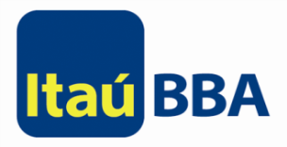
Itaú BBA achieves massive time savings with an application lifecycle management solution
95% reduction in build development efforts
75% decrease in time required for tracking project statuses
50% decrease in operational errors
“As we continue to work with IBM and deploy effective lifecycle management capabilities, we have accelerated our time to market and reduced our build and deployment time by 55 percent.”
—Gabriel Lima, methodology manager, Itaú BBA
Solution components
IBM® Rational® Build Forge®
IBM Rational Quality Manager
IBM Rational Team Concert™
Notes:
10
Speaker notes:
Client Name: Itaú BBA
Case study Link: http://www-01.ibm.com/software/success/cssdb.nsf/cs/KPES-8YJRTT?OpenDocument&Site=corp&ref=crdb
Pull Quote: “As we continue to work with IBM and deploy effective lifecycle management capabilities, we have accelerated our time to market and reduced our build and deployment time by 55 percent, freeing our developers to be more creative and innovate so we can better compete in our market.” — Gabriel Lima, methodology manager, Itaú BBA
Company Background: Itaú BBA is the wholesale, investment and institutional treasury banking division of the Itaú Unibanco group, one of the largest financial conglomerates in the world. Headquartered in Brazil, the division serves institutional investors and companies with sales in excess of BRL150 million. The Itaú BBA IT department has approximately 320 employees and an annual budget of USD200 million.
Solution Components: Software: Rational Team Concert, Rational Quality Manager, Rational Build Forge
The need: Since 2002, Itaú BBA had relied on IBM® Rational® ClearCase®, IBM Rational ClearQuest® and IBM Rational Build Forge® software to support its development efforts. In 2010, the company decided to supplement those applications with additional tools to create a more comprehensive application lifecycle management (ALM) solution to help:
Increase developer productivity and help development teams more quickly deliver software
Improve development governance through greater traceability, integration and transparency
Reduce development documentation through automation and optimization of development workflows
Using Gartner’s Magic Quadrant research as a guide, Itaú BBA selected several best-of-breed ALM tools. The company then further narrowed down the list based on how well the tools could support its primary platform, Microsoft .Net, and based on its previous experience with the tools. Itaú BBA ultimately decided to perform proof-of-concepts with Microsoft Team Foundation Server and the IBM Jazz™ platform.
The transformation: After identifying six primary ALM disciplines and defining 226 requirements, Itaú BBA selected IBM Rational Team Concert™ and IBM Rational Quality Manager software, which run on the IBM Jazz platform and integrate with the bank’s existing Rational Build Forge software. Rational Team Concert software provides a collaborative software configuration management platform that enables the bank to automate work items, builds and planning. The Rational Quality Manager software supports quality plans, test scripts, processes and test resources. Rational Build Forge software supports the build and deployment lifecycle, providing automation for build plans, scripts and deployment.
In the past, the bank’s ALM processes were workflow-based, required a unique development cycle for different sizes and types of projects, and involved a high level of dependency. Using the new ALM platform based on Rational software, the bank’s ALM processes are work item-based, support customized development cycles based on the type of project, and enable parallel work. Similarly, the bank’s old build process was workflow-based, and mixed management and operational tasks in the same workflow. The new build process is based on work items, separates operational and management tasks, and enables work to be performed in parallel.
According to Edson Portilho, ALM specialist, Itaú BBA, “One of the greatest benefits that we identified with the IBM ALM Solution is that it allows developers to focus on tasks related to code production, without dispersing their attention with unnecessary bureaucracy.”
The benefit: In the past, it was difficult for Itaú BBA to extract metrics about its processes. Now, using Rational Team Concert software, the bank can easily track project progress, resulting in a 75 percent reduction in the time spent following-up on project statuses. The bank has also reduced the amount of time spent rewriting documentation by 50 percent and reduced the amount of time spent creating and updating workflows by 27 percent. Further, the bank has reduced the number of problems or delays in development by 10 percent and reduced the amount of time spent per year on development by 8 percent. Within its build and deployment processes, the bank has also achieved significant benefits including:
Reducing the amount of time required for deployment model preparation by 50 percent
Decreasing the amount of time to install development versions by 50 percent
Reducing the amount of effort required to adjust builds by 50 percent
Reducing the amount of time spent creating and modifying workflows by 15 percent
Reducing build time by 30 percent through support for parallel work
Reducing operational errors, such as deploying incorrect artifacts, by 50 percent
Reducing the amount of effort required to create a build by 95 percent
Reducing the amount of time required to determine the version of artifacts in production by 50 percent
All told, the bank reduced the amount of time spent per year on build and deployment by 55 percent.
“Itaú BBA is dedicated to building a trusted and customized relationship with our customers so we can continue to address the complexity of their businesses,” says Luiz Carlos Cesário, architecture superintendent, Itaú BBA. “This attention to customers’ needs requires a constant focus on improving our IT environment to become more efficient and responsive to change.”

Slide 11

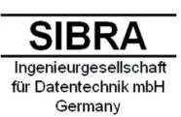
SIBRA GmbH keeps a vital project within budget and on time
50% faster code updates in a prototype scenario
Analysis 10-20 times faster than using a manual approach
Reduces risk of code updates with improved accuracy
“With Rational Asset Analyzer, you can see all the statements that are affected and the complexity of the required changes. You can minimize project risk, and the project planning is nearly perfect.”
—Eberhard Ramm, owner and chief executive officer, SIBRA
Solution components
IBM® Rational® Asset Analyzer for System z®
IBM Rational Developer for System z
Notes:
11
Speaker notes:
Client Name: SIBRA GmbH
Case study Link: http://www-01.ibm.com/software/success/cssdb.nsf/cs/RNAE-968DU7?OpenDocument&Site=corp&ref=crdb
Pull Quote: "With Rational Asset Analyzer, you can see all the statements that are affected and the complexity of the required changes. You can minimize project risk, and the project planning is nearly perfect.… So the project will be within budget and on time." - Eberhard Ramm, owner and chief executive officer, SIBRA
Company Background: Founded in 1980, SIBRA GmbH provides a broad range of technology services, including development, consulting, project management, research, analysis and design. Located in Gröbenzell, Germany, near Munich, the company has proven expertise working with various operating systems, databases, programming languages and network protocols.
Solution Components: Software: Rational Asset Analyzer for System z, Rational Developer for System z
The need: SIBRA has worked with a major manufacturer for more than 10 years, providing support for the company’s mainframe computers, compilers, databases and development environments. Around 1978, the manufacturer established four-digit serial numbers for its products. But when the company approached its 8,000th model, it realized it was going to run out of available serial numbers. “Now they are nearly at 8,000, so they have to do something to extend the serial number field,” says Eberhard Ramm, owner and chief executive officer at SIBRA. However, the manufacturers’ more than 7,000 mainframe programs all include references to this serial number, so changing it required significant analysis and planning. The manufacturer asked SIBRA to acquire an appropriate source code analyzer tool that it could use to identify all instances of the serial number in its mainframe applications, as well as its IBM® DB2® data servers and IBM Information Management System databases.
The transformation: SIBRA and the manufacturer performed a market analysis and found two potential products, submitting questionnaires to two companies: IBM and EZLegacy. Based on questionnaire results, SIBRA recommended that the company use IBM Rational® Asset Analyzer for System z® software to address its serial number extension. Rational Asset Analyzer for System z software provides built-in support for the DB2 data servers and Information Management System databases. Plus, IBM offered support for job control language (JCL) and the compilers that the company uses. “In Java, you have these tools everywhere, but not on the mainframe. The mainframe, with COBOL, with PL/1, with Assembler, it’s difficult to find powerful and large-scale tools,” says Ramm. Using Rational Asset Analyzer for System z software to do an impact analysis helps developers, in just a few minutes, get an overview of the dependencies and details involved in making an update such as the serial number extension. “A developer can then choose a variable declaration that he knows represents the serial number and start an impact analysis,” says Ramm. “This returns all the programs, variables/fields and subsystem items that interact with the developer’s chosen variable.”
The benefit: in approximately three weeks, SIBRA gathered a comprehensive inventory of the applications that the serial number extension affected. Rational Asset Analyzer for System z software stored and managed all the information gathered on a central DB2 data server, where developers from across the enterprise could access it. Then, within four weeks and working on weekends only, SIBRA performed the initial load of the repository, scanning approximately 7,200 programming language one (PL/1) programs; 100 assembler language programs; a few COBOL programs; DB2 data servers; Information Management System databases and transactions; and all referenced Include, Copy and Macro libraries. Finally, SIBRA scanned a batch of JCL files including 6,000 jobs. “Rational Asset Analyzer for System z software automatically scans the source programs and subsystems on System z and stores the meta information in a DB2 repository. Additionally, we use the Rational Asset Analyzer batch interface to send a scan request for each changed and released program to keep the repository current,” says Ramm. “With Rational Asset Analyzer, you can see all the statements that are affected and the complexity of the required changes. You can minimize project risk, and the project planning is nearly perfect. You do not forget anything. So the project will be within budget and on time.” After identifying the code changes, developers can then use IBM Rational Developer for System z software to change the actual code. Eclipse technology-based interfaces between Rational Asset Analyzer for System z and Rational Developer for System z software help developers make these code changes using the same user interface, through an integrated Eclipse workspace. Using Rational Asset Analyzer for System z software, SIBRA was able to update the serial number in a prototype scenario approximately 50 percent faster than it would have using other tools. Performing the analysis manually would have taken 10 to 20 times longer than it did using the Rational software, and the manual approach would have introduced more risk and yielded a less thorough result. Ramm anticipates that the manufacturers’ developers will have ample opportunity to use the Rational Asset Analyzer for System z application in the future. “Sometimes we use it for diagnosis or to find errors,” he says, “because when you have a problem with a field in the program, you can look to see where it’s used, which programs and which statements. You’ll see where the program is going wrong. The tool is very powerful. You can search for nearly everything.”

Slide 12


VP SECURITIES A/S – IBM Rational software and EGL technology facilitate migration and modernization
Reduced costs of the supporting technology for a mission-critical bank service
Migrated 1.8 million lines of code with just one minor production issue
Gained multiplatform support to deliver greater flexibility
The transformation: VP SECURITIES A/S needed to find a new technology platform to support a key banking service that could deliver excellent scalability, support for open standards and multiplatform execution capabilities. By migrating to IBM® Rational® Business Developer software, VP reduced the cost of its platform and maintained the required service levels for customers.
Solution components
IBM® InfoSphere® Data Architect
IBM Rational® Business Developer
IBM Business Partner
Xact Consulting A/S
“The acceptance of this new environment was measured in weeks, and that impressed us all.”
—Kim Reinert, head of methods and architecture, VP SECURITIES A/S
Notes:
12
Client Name: VP SECURITIES A/S cuts costs with modern development tools
Case study Link: http://www.ibm.com/common/ssi/cgi-bin/ssialias?subtype=AB&infotype=PM&appname=SWGE_RA_RA_USEN&htmlfid=RAC14319USEN&attachment=RAC14319USEN.PDF
Pull Quote:
“The acceptance of this new environment was measured in weeks, and that impressed us all.”
—Kim Reinert, head of methods and architecture, VP SECURITIES A/S
Company Background:
VP SECURITIES A/S is a financial services company offering innovative solutions and expertise in the field of securities and investor administration. A privately held company, VP is one of the leading providers of securities and investor services in Denmark and also offers its services globally. The company is an approved Central Securities Depository (CSD) in Denmark and Luxembourg, providing access to a long line of international markets through collaboration with other securities depositories.
Solution components:
Software
IBM® InfoSphere® Data Architect
IBM Rational® Business Developer
IBM Business Partner
Xact Consulting A/S
Business challenge:
VP SECURITIES A/S needed to replace its CA Gen software from CA Technologies with a new solution that would support its mission-critical, mainframe-based Central Securities Depository (CSD) service.
The benefit:
VP cut development costs of the CSD service using technology that facilitates mainframe and distributed development, and it consolidated newer and experienced developers into a single environment.

Slide 13


CACEIS – boosts communication and collaboration
Cuts costs
through improved communication
between development teams
Shortens debugging
time for applications through a common communication platform that improves operational efficiency
The transformation: To minimize bugs and reduce time to market, Caceis needed to establish more effective communication between its open platform and mainframe teams, which were spread out in three separate countries. Caceis implemented IBM® Rational® Team Concert™ software to support its teams with features such as communication in context, event feeds, integrated chat and automated traceability.
Helps increase revenue
potential with shortened time to market for new product development
“Thanks to Rational Team Concert software, our teams can collaborate and develop programs that are increasingly robust in a minimum of time, helping us meet the needs of our customers at a lower cost.”
—Bertrand Avé, architect, open programs, CACEIS
Solution components
IBM® Rational Team Concert™ software
IBM System z platform
Notes:
CACEIS is an international bank with operations in 11 countries. A member of the Crédit Agricole Group, CACEIS primarily serves other banks and financial institutions.
The company was having difficulty establishing effective communication between its open platform and mainframe teams. It often found that when it combined components from the two teams to create its applications, the components couldn’t be properly linked, causing bugs. CACEIS began to look for a solution that could help it improve collaboration between its development teams, reduce development time and cut costs.
CACEIS implemented IBM Rational Team Concert™ software. Based on the BM Jazz™ platform, the Rational® application supports geographically distributed teams by providing features such as communication in context, event feeds, integrated chat and automated traceability.
Using the Rational software helped CACEIS improve communication and collaboration between development teams, boosting productivity. It has therefore been able to shorten time to market for new products, improving customer satisfaction levels.

Slide 14

Putting DevOps into Practice

Slide 15
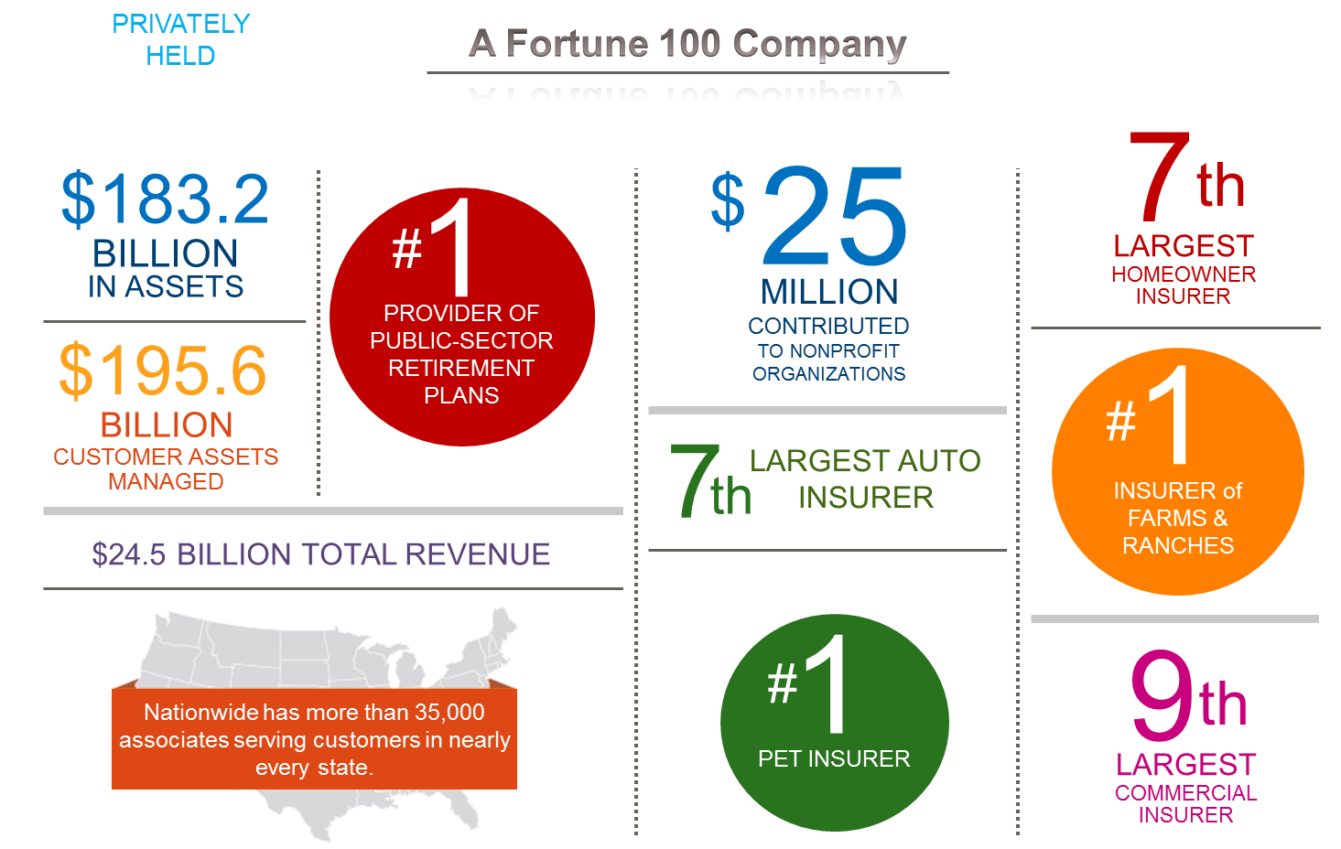
Thriving in a Dynamic, Highly-regulated World
©2014. Nationwide Mutual Insurance Company and Affiliated Companies
Notes:
Nationwide Top 100 Fortune Company
30K+ Associates
Several LOBs (Auto, Life, Home, Financial, Banking, Retirement Plans, Pet Insurance)

Slide 16
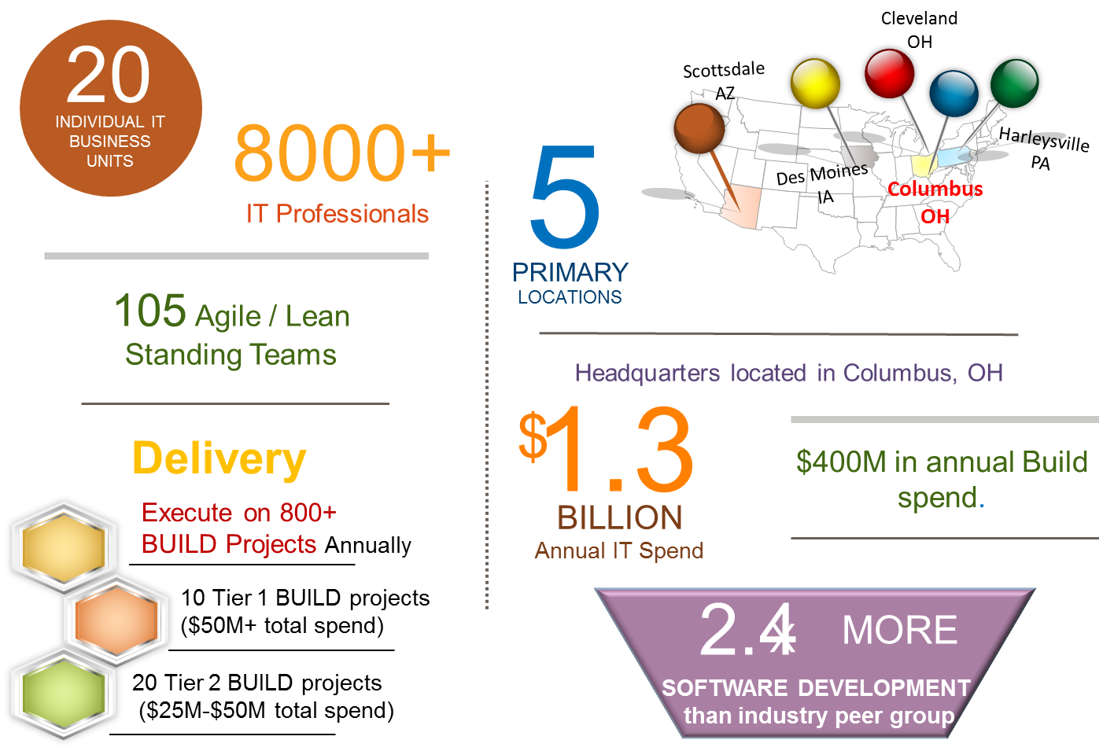
Information Technology
60% of all PROJECT Work done by Agile Teams
35%
Annual
Increase in # of Agile Teams
©2014. Nationwide Mutual Insurance Company and Affiliated Companies
Notes:
Almost 2K Developers
Agile standing team model growing each year
Growth organic based on sustainable results (higher quality, higher productivity, higher customer satisfaction and involvement)

Slide 17
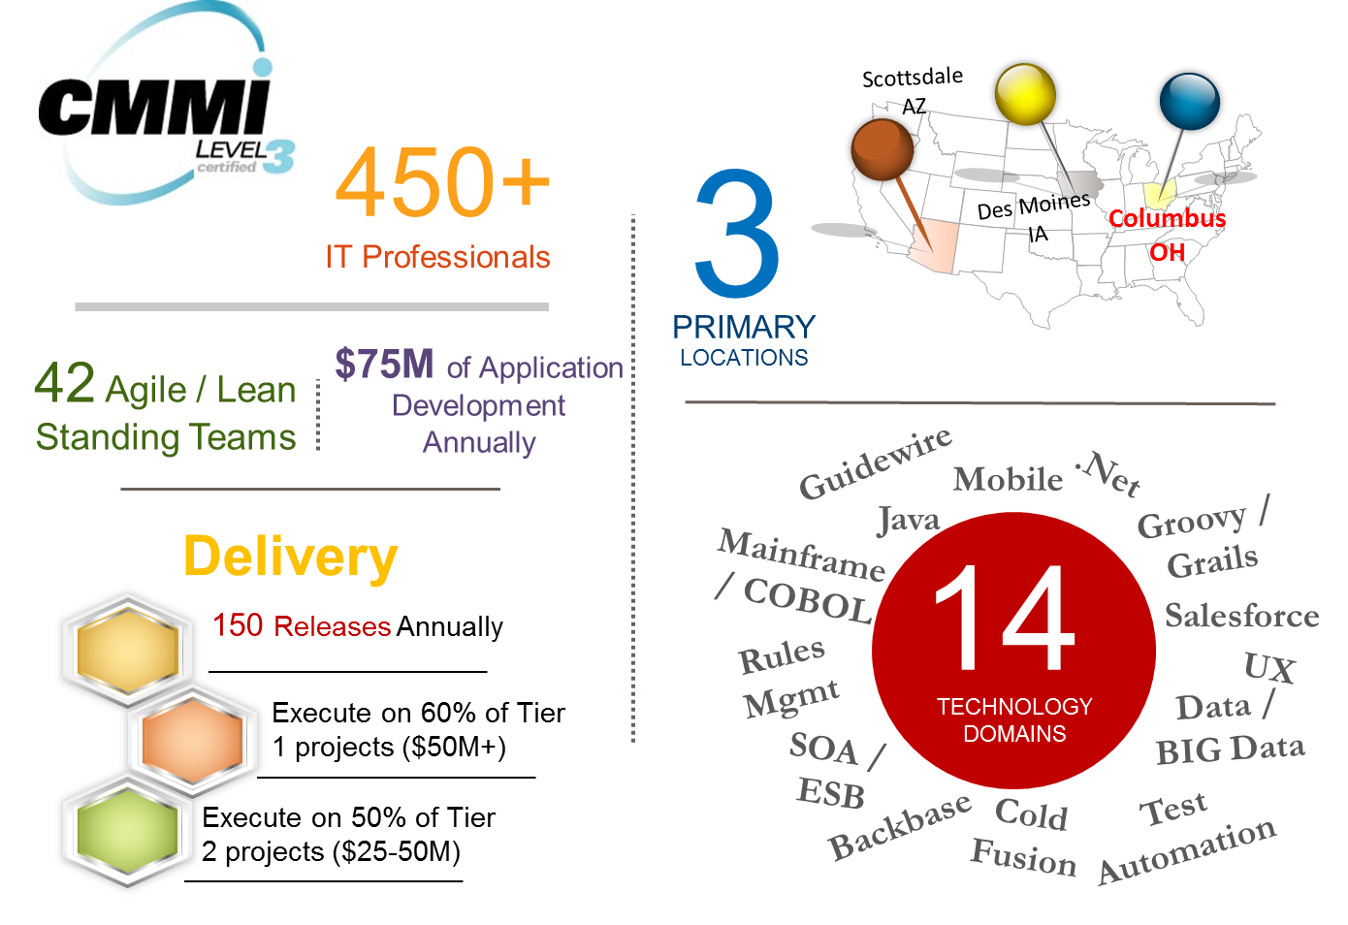
Application Development Center (ADC)
Established
CI, CT & CD Practices
©2014. Nationwide Mutual Insurance Company and Affiliated Companies
Notes:
Formed in 2009 as a reaction to changing the delivery model
Agile Projects started in late 90s but constant form, storm, norm, perform did not produce sustainable process changes
Changed Delivery Model from bring people to work to bringing work to the people in the form of established teams
Project Teams are lighter with most of the heavy lifting done by application based Agile teams across all technologies

Slide 18
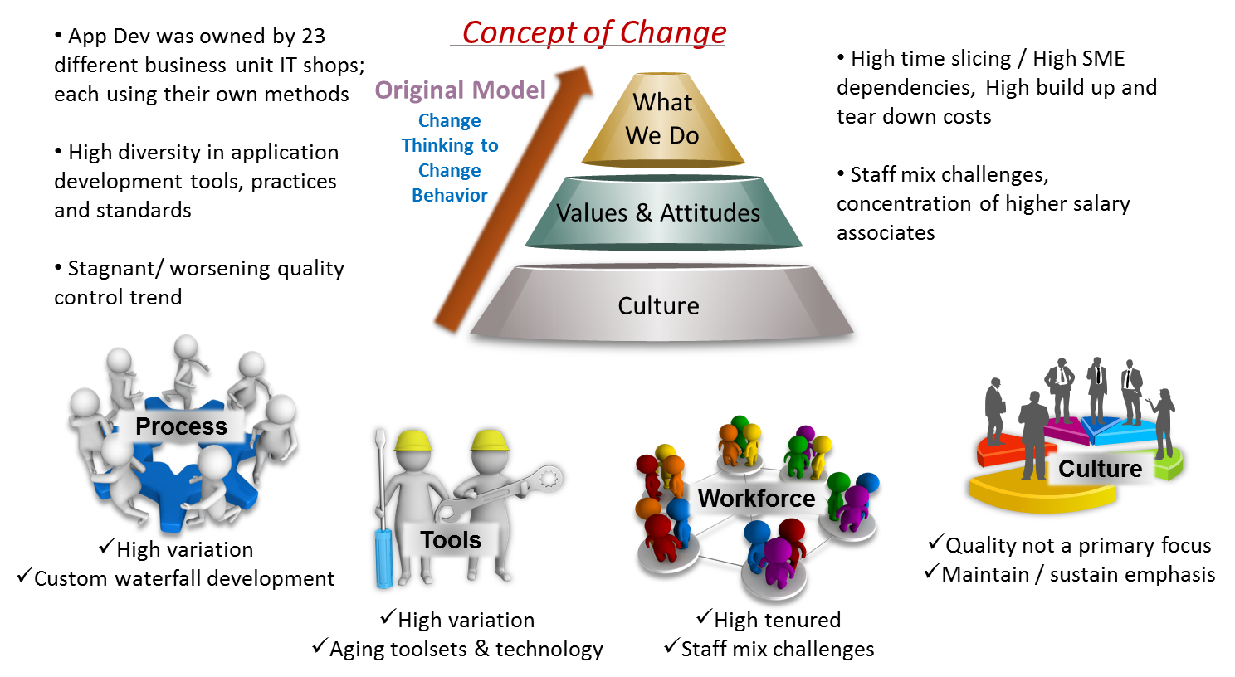
DevOps – Where We Started
First Phase: Small Kernel of teams focused on Systems of ENGAGEMENT
©2014. Nationwide Mutual Insurance Company and Affiliated Companies
Notes:
Started small with a handful of teams across offices (NI and NF) with their own flavors of Agile – started with Believers
Started primarily with J2EE teams
Management Practices and Engineering Practices
Created standard work and applied to all teams
Needed time/cover to product results – initially all problems (even Infrastructure) were easy to blame on those “agile guys”
After a year, the results sold the method – CMMI was used to demonstrate this wasn’t some fly by night seat of the pants operation

Slide 19
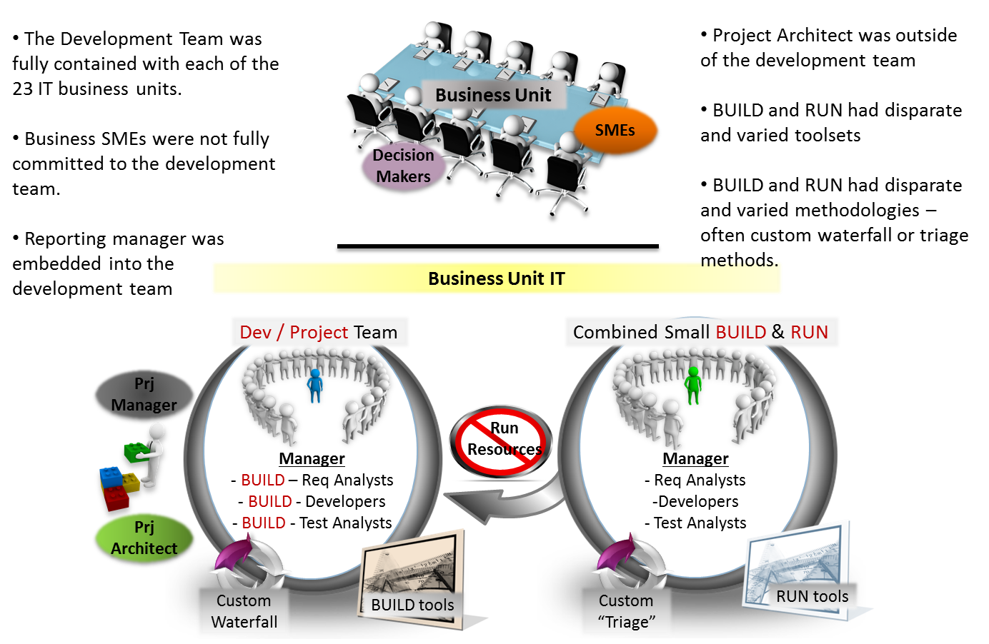
DevOps – Where We Started: The Dev Team
Next Phase: Broader Application to Systems of RECORD
©2014. Nationwide Mutual Insurance Company and Affiliated Companies
Notes:
Standardized around practices and tooling with a strong commitment to Continuous Improvement
Branched out to other areas and technologies (Site RPs mainframe technologies) with modernization approach
Challenge of how to do engineering practices like CI/CD/CT with mainframe (Rational tooling)
Can’t use standard tools without standard work practices
FOCUS on DEV environment – CI and TDD – Acceptance Test Criteria – testing stories in same iteration that they were developed
Service Virtualization – deployments to DEV several times a day
RDz and RD&T for mainframe

Slide 20
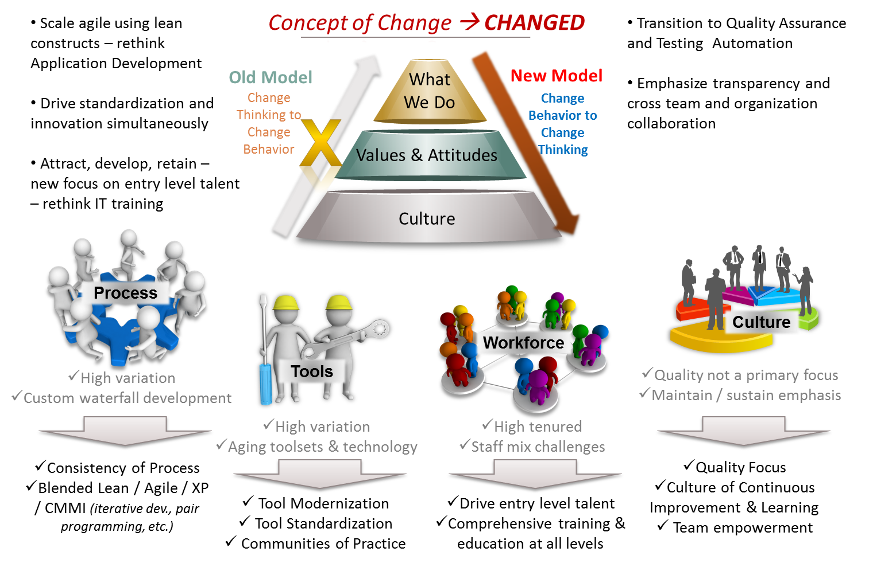
DevOps – The Road to Change
Steady State Balance of Innovation & Discipline
©2014. Nationwide Mutual Insurance Company and Affiliated Companies
Notes:
Success breeds more success
Growth had to be controlled
Standard services provided around patterns of environment deployment (Hudson, Maven, Sonar, Security Scans, etc)
Coaching within ECTO

Slide 21
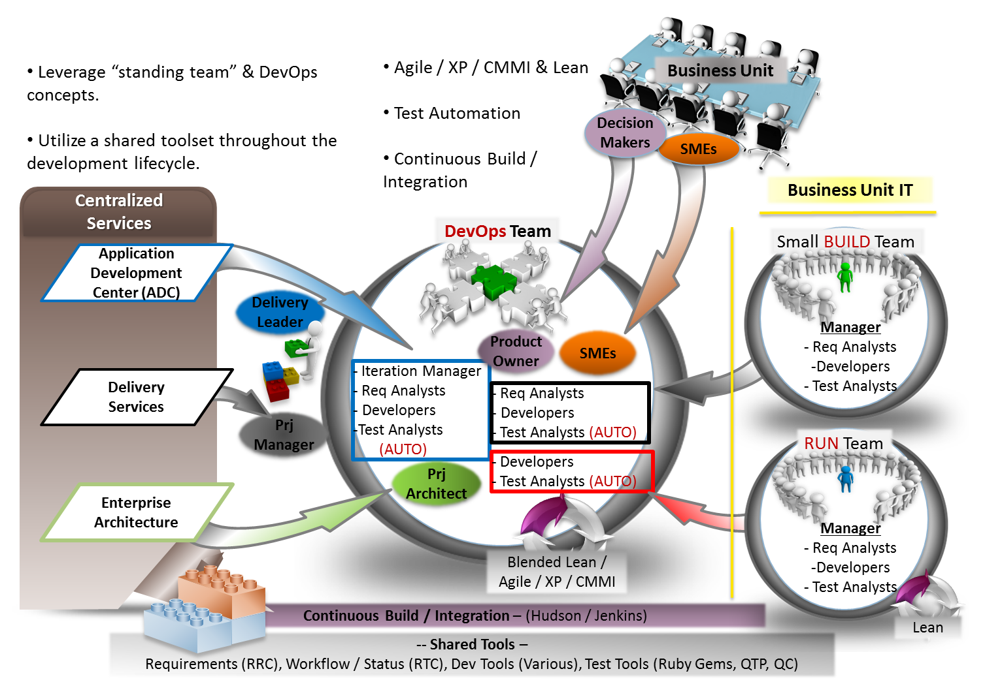
DevOps – Where We Are
Shared Service Offerings
Rational Development and Test Enterprise for System z (RD&T), Rational Developer for System z (RDz), Rational Asset Analyzer (RAA),and Rational Application Developer (RAD)
©2014. Nationwide Mutual Insurance Company and Affiliated Companies
,
Notes:
Shared Services across ECTO and Infrastructure – about 2 dozen coaches
Water-SRUM-Fall – need to optimize end to end now
Starvation waiting for work
Downstream contention for managed environments
Hidden Factory – no end to end model or view of work flow
Eliminate dependences through Service Virtualization and Test Data Management

Slide 22

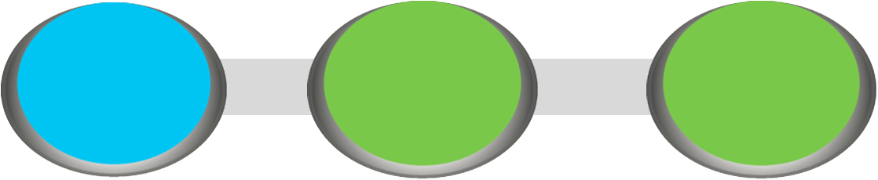



Where We Are Going: Continuous Delivery Model
Project Manager
Tester
Security Scans
Hudson/Maven
Continuous
Integration
Projects/Work Requests
Defects & Test Status
Security Scan
Status
Deployment
Requests
Releases
Release
Mgmt
Deployment Policies
Change & Config Mgmt Information
ITSM
RTC
Release
Planning
UCR
Deployment
Mgmt
UCD
Iterations
Release
Dashboard
User
Stories
Deployment
Work items
Deployment Status
Target (IT, ST, PROD)
Apply Lean Principles to Optimize Delivery
Utilizing Integrated Work Flow & Technologies
RRC
UCD Agent
Notes:
Continuous Delivery Model
Trust and Automation
Tasktop and continuous flow and view of work and dependency impacts
Complex model with Many to Many relationship between Business Areas and Applications

Slide 23
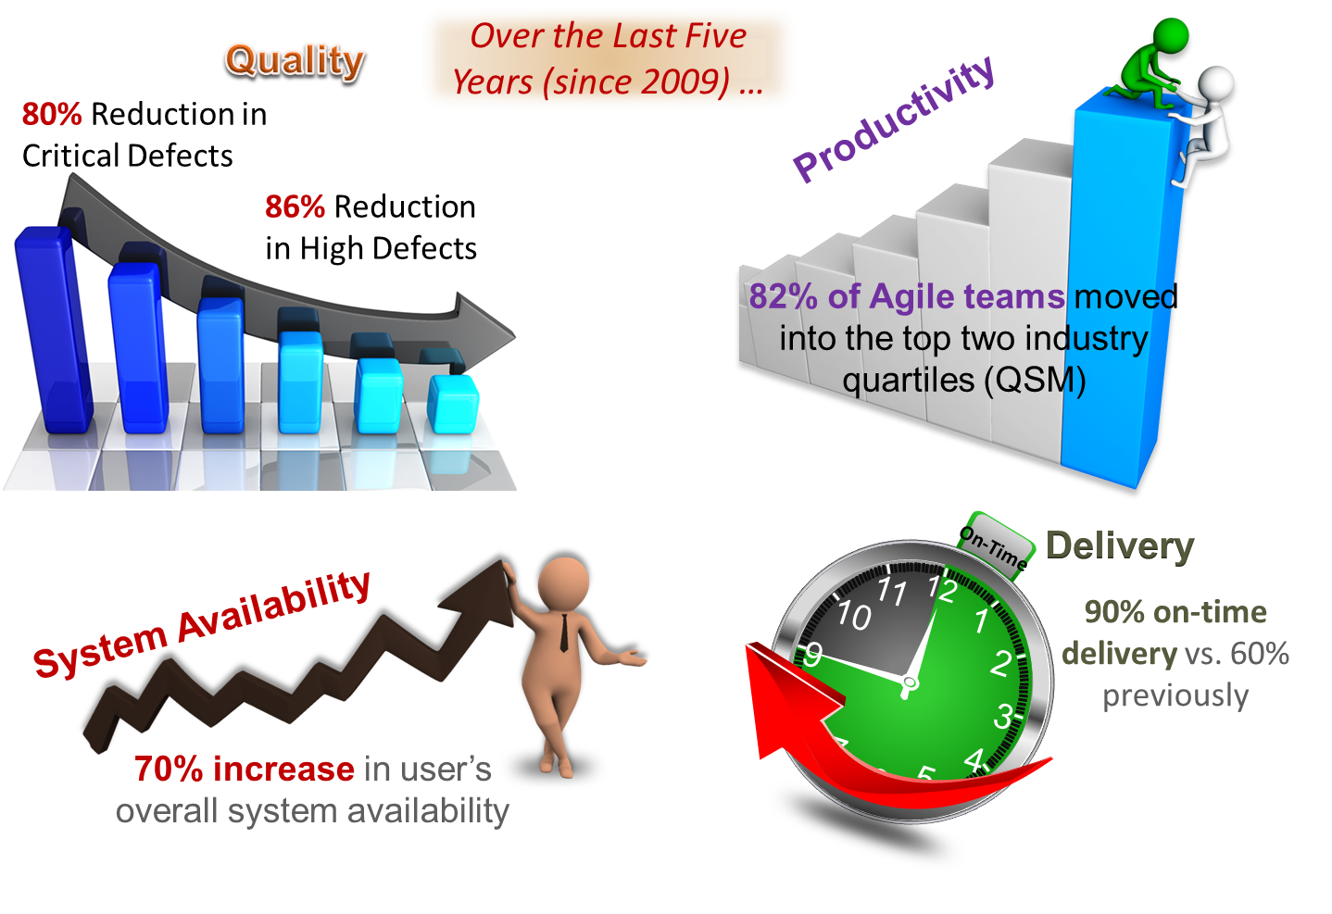
Results / Impacts
©2014. Nationwide Mutual Insurance Company and Affiliated Companies

Slide 24

We Could Use Help With
Creating an Agile Business Planning Culture
Providing Product Ownership for Shared Applications
Overcoming Fear Associated with disruption of comfortable Silos
Determining what role (if any) ITIL plays in a true DevOps Culture
Techniques to move Executives from a “Fixed Mindset” to an “Adaptive Mindset”
New generation of Metrics which places focus on sustainable and continuous release capabilities instead of simply Project Delivery
Notes:
Help areas – less focus on transient projects and more on releases

